Slide 1


Summer 2023 Senior Design Project
AI on Low-cost Camera for Counting and Classification of Microbes in Nature Water
Team Members: Artem Andrianov, Mojeed Oladele Ashaleye, Amanda Beatriz Chacin-Livinalli, Noah C Cuevas, Max Samuel Karey
Product Owner: Dr. Antao Chen, Beckman Coulter
Instructor: Dr. S. Masoud Sadjadi
School of Computing and Information Sciences
Florida International University
July 28th, 2023

Slide 2
Motivation
Traditional methods of water monitoring and classification of water borne microbes require expensive, time-consuming, and labor intensive processes.
This hinders the extent of discovery able to be made by scientists and water quality and health officials.
Utilizing artificial intelligence as a tool in these efforts could pose a new approach that is convenient, efficient and reliable.

Slide 3


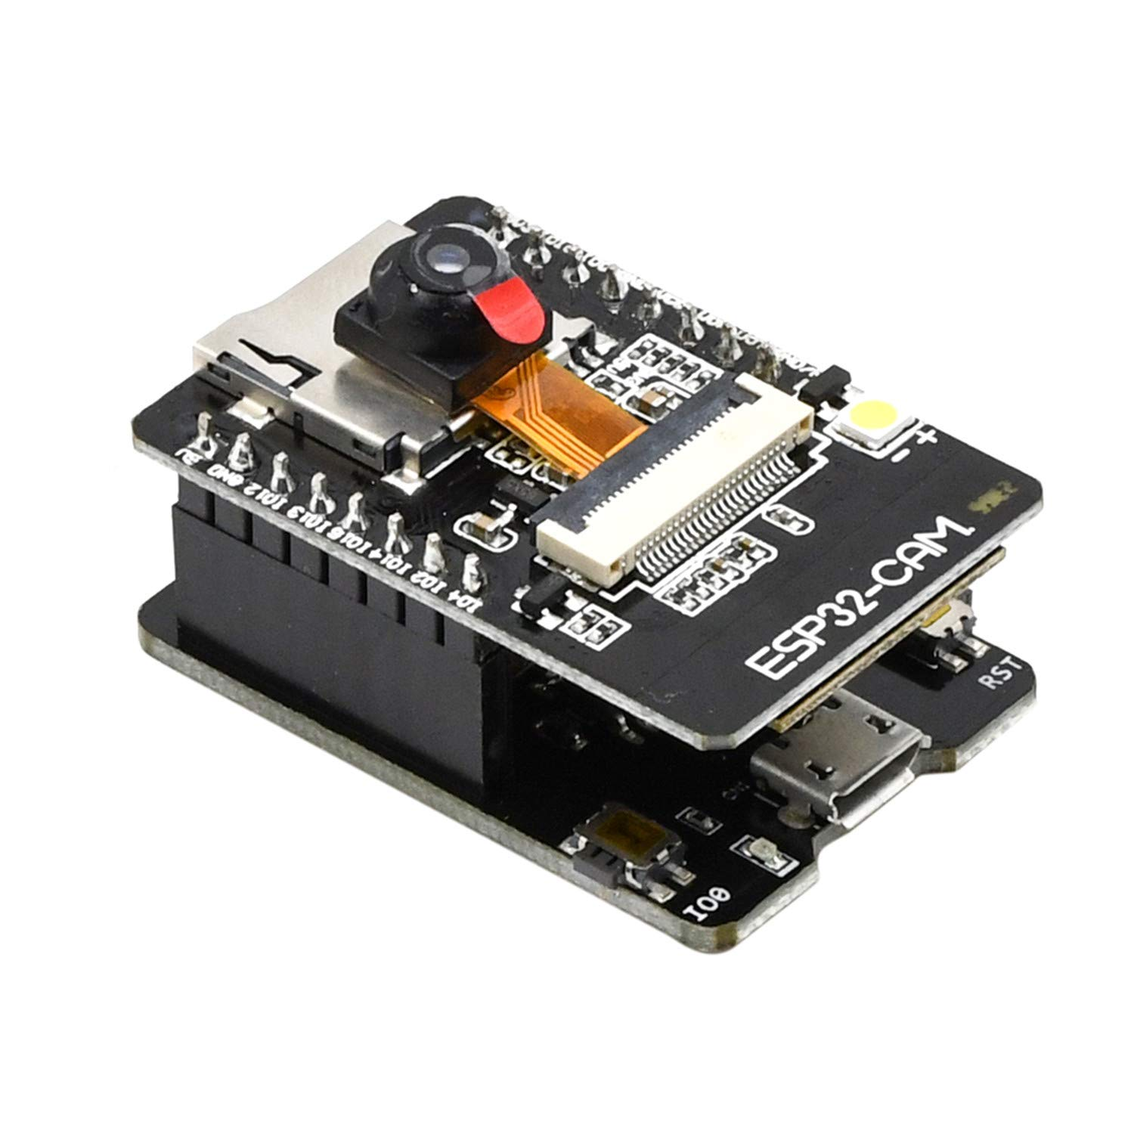
Solution
This project developed an artificial intelligence-based model to work in conjunction with a low-cost camera and microscope to detect and classify microbes in water samples.
This system aims to:
Automatically detect and classify microbes in natural water and,
Produce real-time inference from data provided by the camera’s live video stream.

Slide 4
Approach
We tackled the issue of algae classification under a microscope using a low-cost camera by utilising a neural network developed on the Edge Impulse and trained to identify different types of algae from water sample.
To capture live images and video OS microbe sample, we connected an ESP-32 camera to a Nikon light microscope.
The camera chip sent the data to a web server that collected and formed out dataset.

Slide 5
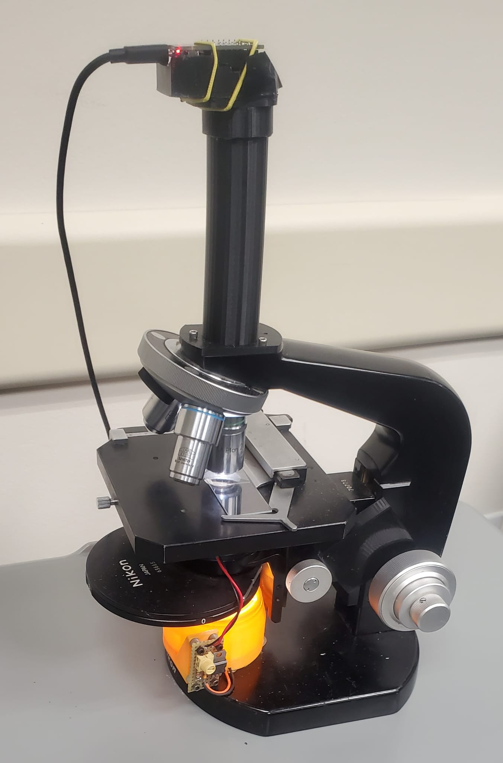
Approach, continued.
We utilised a Convolutional Neural Network(CNN) to train the model. The dataset was used to teach the model how to distinguish between various algae species.
Edge Impulse was used to train the CNN with the provided dataset and parameters for optimal performance.
The trained model was integrated it into a library that was later uploaded to the ESP32-CAM chip.

Slide 6
Project Development: Sprint 1 & 2
The project was developed across 5 sprint development sessions throughout the Summer 2023 term.
Sprint 1:
Finding image dataset, investigated camera options, identified suitable libraries and performed background research on skills needed.
Sprint 2:
Continued finding image dataset, reached out to biologists for potential guidance, built dataset of >2,000 photos of algae from samples of FIU ponds along with Kaggle-supplied photos, continue researching on skills needed.

Slide 7
Project Development: Sprint 3 & 4
Sprint 3:
Built algae dataset utilising 5 individual categories, began building Keras CNN model, generated additional images for dataset, and preprocessed our images using Keras.
Sprint 4:
Attempted to export Keras model onto chip, troubleshooted exporting of model onto chip with no success, began building Edge Impulse model and generated more images for dataset.

Slide 8
Project Development: Sprint 5
Sprint 5:
Created Github repository, developed a model using Edge Impulse, troubleshooted loading of model library onto Arduino IDE, attempted to integrate camera web server and Edge Impulse model in Arduino, troubleshooted loading of model onto ESP32-CAM, successfully inferencing model on ESP32-CAM.

Slide 9
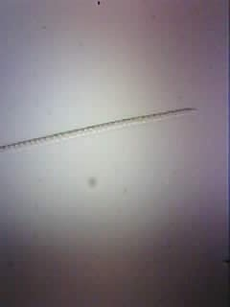
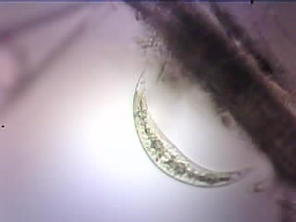
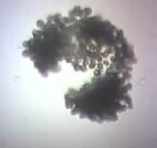
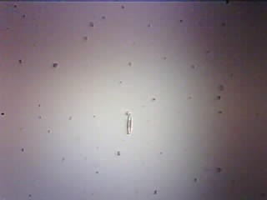
Data
Oscillatoria Closterium Microcystis Nitzschia

Slide 10
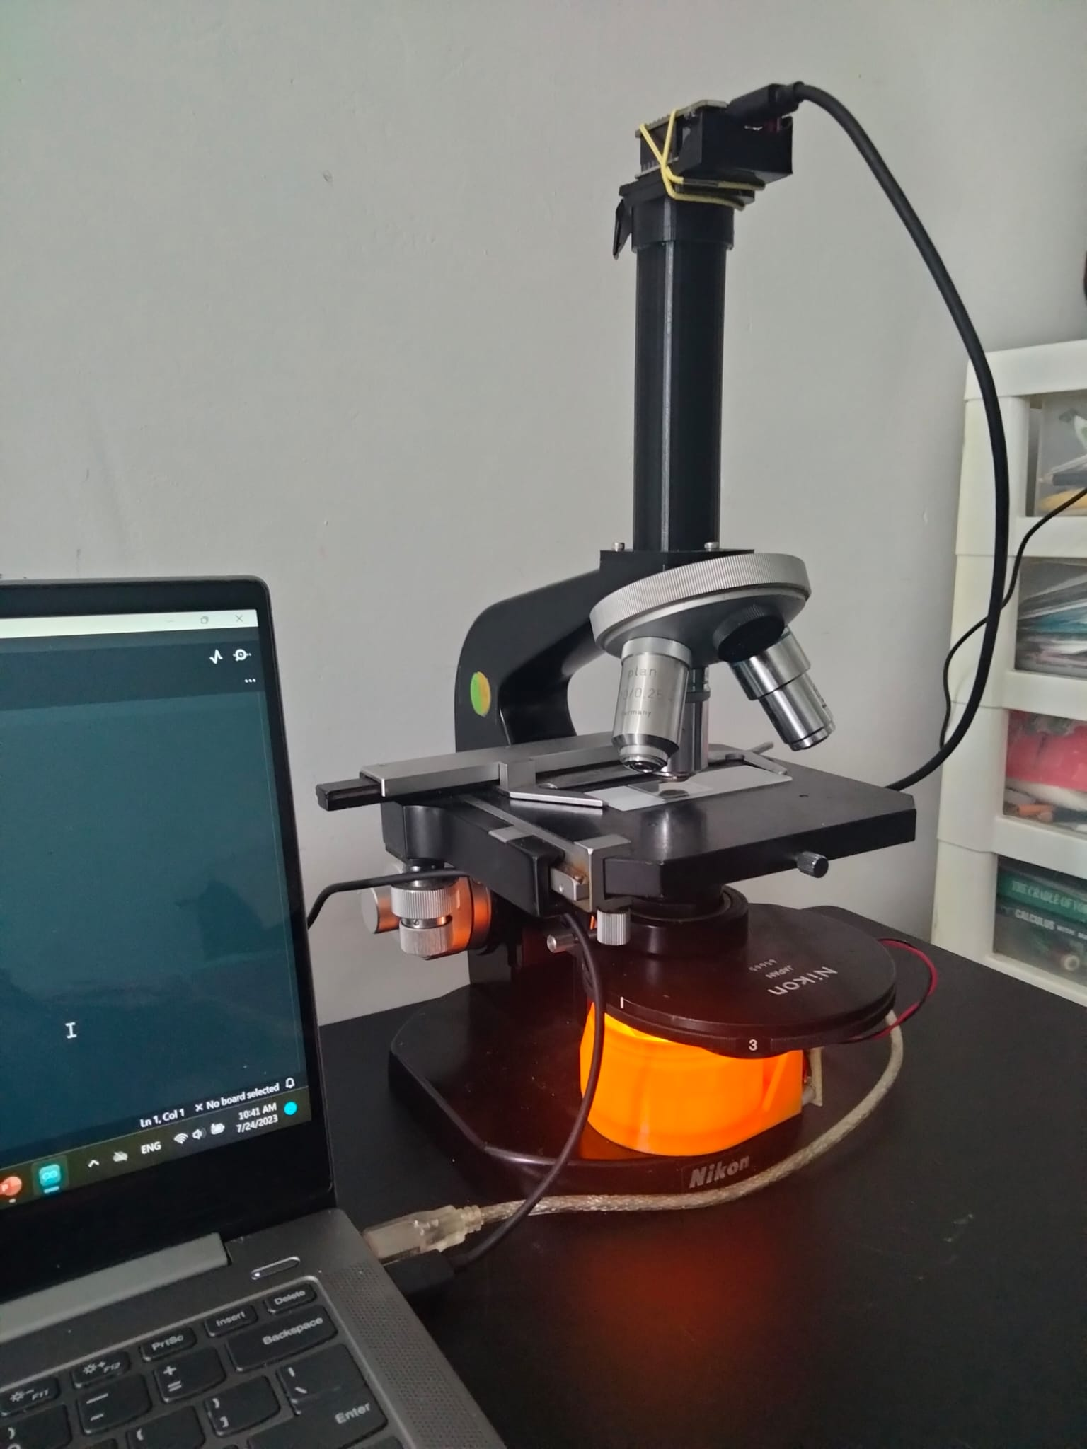
Implementation
The system was implemented using:
a windows computer with a 64-bit operating system, 256GB storage, 12GB of memory, and an Intel® Core™ i5- 10210U CPU at 1.60GHz.
The Arduino IDE as the development environment used to run the systems program
An ESP-32 Camera development board mounted onto a Nikon light microscope

Slide 11
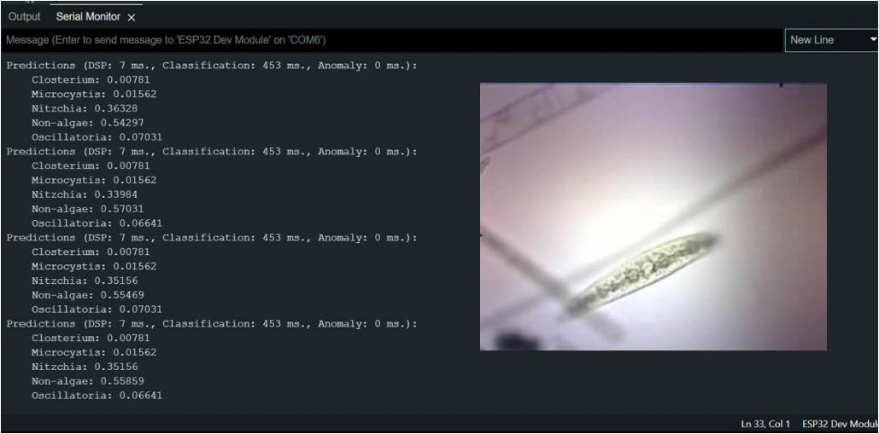
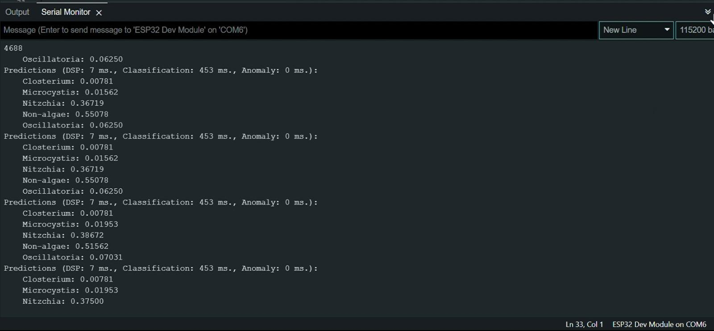
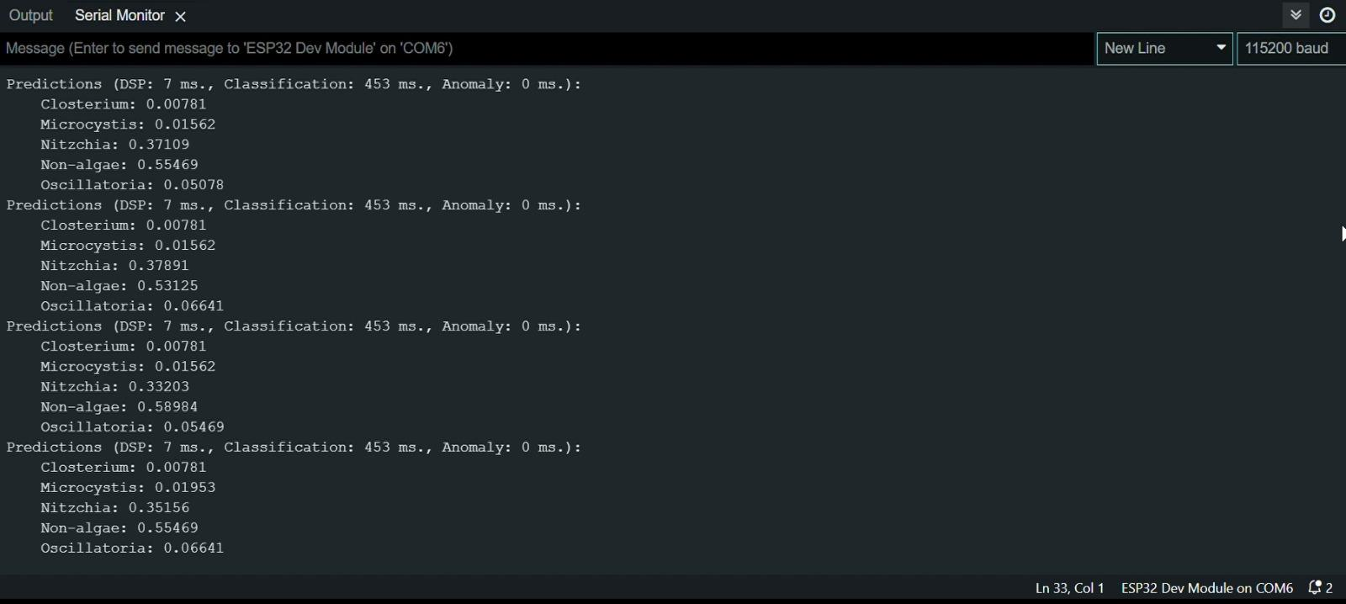
Results

Slide 12
Conclusion
This project utilizes AI-driven water monitoring with a low-cost camera and microscope and poses an innovative approach for new water monitoring methods.
The Edge Impulse-trained Convolutional Neural network allows for automatic microbe detection and real-time inferences.
This new approach could allow scientists and officials an alternative method of water monitoring that reduces cost while being efficient and reliable.

